Slide 1
The Markets for
the Factors of Production
© 2015 Cengage Learning. All Rights Reserved. May not be copied, scanned, or duplicated, in whole or in part, except for use as permitted in a license distributed with a certain product or service or otherwise on a password-protected website for classroom use.

Slide 2
Factors of Production
Factors of production
  Inputs used to produce goods and services
    Labor
    Land
    Capital
Demand for a factor of production
  Derived demand
    From firm’s decision to supply a good in another market
© 2015 Cengage Learning. All Rights Reserved. May not be copied, scanned, or duplicated, in whole or in part, except for use as permitted in a license distributed with a certain product or service or otherwise on a password-protected website for classroom use.

Slide 3
The Demand for Labor
Labor market
  Governed by supply and demand
Labor demand
  Derived demand
  Labor services = inputs into the production of other goods
© 2015 Cengage Learning. All Rights Reserved. May not be copied, scanned, or duplicated, in whole or in part, except for use as permitted in a license distributed with a certain product or service or otherwise on a password-protected website for classroom use.

Slide 4
Figure 1
The Versatility of Supply and Demand
(a) The market for apples
(b) The market for apple pickers
Price
of
apples
Wage
of
apple
pickers
Supply
Supply
P
W
Demand
Demand
0
Q
Quantity
of apples
0
L
Quantity of
apple pickers
The basic tools of supply and demand apply to goods and to labor services. Panel (a) shows how the supply and demand for apples determine the price of apples. Panel (b) shows how the supply and demand for apple pickers determine the wage of apple pickers.
© 2015 Cengage Learning. All Rights Reserved. May not be copied, scanned, or duplicated, in whole or in part, except for use as permitted in a license distributed with a certain product or service or otherwise on a password-protected website for classroom use.

Slide 5
The Demand for Labor
Assumptions for the competitive firm
  Firm is competitive in both markets
    For goods and for labor
    Price taker
      Pay the market wage
      Get the market price for goods
    Decide
      Quantity of goods to sell
      Quantity of labor to hire
  Firm is profit-maximizing
© 2015 Cengage Learning. All Rights Reserved. May not be copied, scanned, or duplicated, in whole or in part, except for use as permitted in a license distributed with a certain product or service or otherwise on a password-protected website for classroom use.

Slide 6
The Demand for Labor
Production function
  Relationship between the quantity of inputs used to make a good
  And the quantity of output of that good
  Becomes flatter as the quantity of input increases
© 2015 Cengage Learning. All Rights Reserved. May not be copied, scanned, or duplicated, in whole or in part, except for use as permitted in a license distributed with a certain product or service or otherwise on a password-protected website for classroom use.

Slide 7
The Demand for Labor
Marginal product of labor (MPL)
  Increase in the amount of output
  From an additional unit of labor
Diminishing marginal product
  The marginal product of an input declines
  As the quantity of the input increases
  Explains the shape of the production function
© 2015 Cengage Learning. All Rights Reserved. May not be copied, scanned, or duplicated, in whole or in part, except for use as permitted in a license distributed with a certain product or service or otherwise on a password-protected website for classroom use.

Slide 8
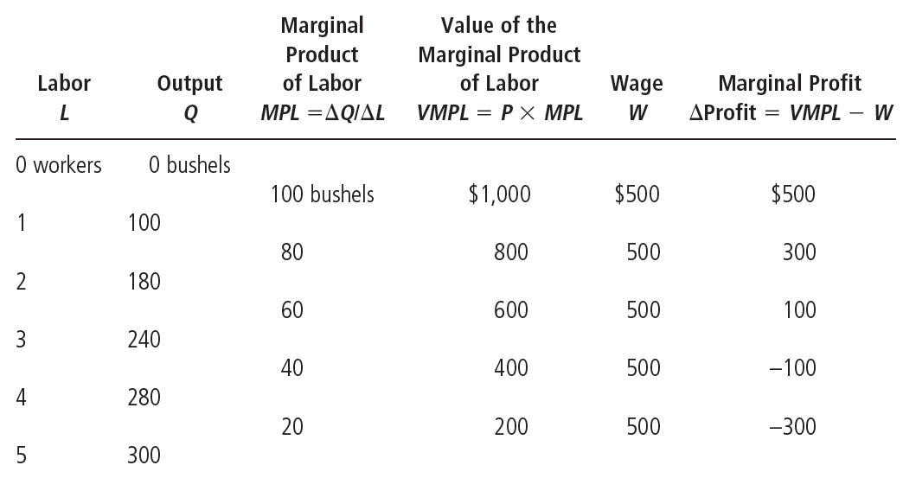
Table 1
How the Competitive Firm Decides How Much Labor to Hire
© 2015 Cengage Learning. All Rights Reserved. May not be copied, scanned, or duplicated, in whole or in part, except for use as permitted in a license distributed with a certain product or service or otherwise on a password-protected website for classroom use.

Slide 9
Figure 2
The Production Function
Quantity
of
apples
Production function
300
280
240
180
100
0
1
2
3
4
5
Quantity of
apple pickers
The production function shows how an input into production (apple pickers) influences the output from production (apples). As the quantity of the input increases, the production function gets flatter, reflecting the property of diminishing marginal product.
© 2015 Cengage Learning. All Rights Reserved. May not be copied, scanned, or duplicated, in whole or in part, except for use as permitted in a license distributed with a certain product or service or otherwise on a password-protected website for classroom use.

Slide 10
The Demand for Labor
Value of the marginal product of labor (VMPL)
  Marginal product of labor times the price of the output
  Marginal revenue product
    Additional revenue from hiring one additional unit of labor
  Diminishes as the number of workers rises
© 2015 Cengage Learning. All Rights Reserved. May not be copied, scanned, or duplicated, in whole or in part, except for use as permitted in a license distributed with a certain product or service or otherwise on a password-protected website for classroom use.

Slide 11
Figure 3
The Value of the Marginal Product of Labor
Value of the
marginal
product
Market
wage
Value of marginal product
(demand curve for labor)
0
Profit-maximizing quantity
Quantity of
apple pickers
This figure shows how the value of the marginal product (the marginal product times the price of the output) depends on the number of workers. The curve slopes downward because of diminishing marginal product. For a competitive, profit-maximizing firm, this value-of-marginal-product curve is also the firm’s labor-demand curve.
© 2015 Cengage Learning. All Rights Reserved. May not be copied, scanned, or duplicated, in whole or in part, except for use as permitted in a license distributed with a certain product or service or otherwise on a password-protected website for classroom use.

Slide 12
The Demand for Labor
Competitive, profit-maximizing firm
  Hires workers up to the point where the value of the marginal product of labor = wage
The value-of-marginal-product curve
  Is the labor-demand curve
Labor-demand curve
  Reflects the value of marginal product of labor
© 2015 Cengage Learning. All Rights Reserved. May not be copied, scanned, or duplicated, in whole or in part, except for use as permitted in a license distributed with a certain product or service or otherwise on a password-protected website for classroom use.

Slide 13
The Demand for Labor
Shift in the labor-demand curve
  Change in the output price
    Demand for labor: VMPL = MPL ˣ P of output
  Technological change
    Technological advance
      Can raise MPL: increase demand for labor
    Labor-saving technology
      Can reduce MPL: decrease demand for labor
  Supply of other factors
    Affect marginal product of other factor
© 2015 Cengage Learning. All Rights Reserved. May not be copied, scanned, or duplicated, in whole or in part, except for use as permitted in a license distributed with a certain product or service or otherwise on a password-protected website for classroom use.

Slide 14

The Supply of Labor
Trade-off
  Work vs. leisure
Labor-supply curve
  Reflects how workers’ decisions about the labor-leisure trade-off
  Respond to a change in opportunity cost of leisure
“I really didn’t enjoy working five days a week, fifty weeks a year for forty years, but I needed the money.”
© 2015 Cengage Learning. All Rights Reserved. May not be copied, scanned, or duplicated, in whole or in part, except for use as permitted in a license distributed with a certain product or service or otherwise on a password-protected website for classroom use.

Slide 15
The Supply of Labor
Shift in the labor-supply curve
  Changes in tastes
    Change in attitude toward work
  Changes in alternative opportunities
    Opportunities available in other labor markets
  Immigration
    Movement of workers from region to region or country to country
© 2015 Cengage Learning. All Rights Reserved. May not be copied, scanned, or duplicated, in whole or in part, except for use as permitted in a license distributed with a certain product or service or otherwise on a password-protected website for classroom use.

Slide 16
Equilibrium in the Labor Market
Wages in competitive labor markets
  Adjusts to balance the supply & demand for labor
  Equals the value of the marginal product of labor
Changes in supply or demand for labor
  Change the equilibrium wage
  Change the value of the marginal product by the same amount
© 2015 Cengage Learning. All Rights Reserved. May not be copied, scanned, or duplicated, in whole or in part, except for use as permitted in a license distributed with a certain product or service or otherwise on a password-protected website for classroom use.

Slide 17
Figure 4
Equilibrium in a Labor Market
Wage
(price of
labor)
Supply
Equilibrium
wage, W
Demand
0
Equilibrium
employment, L
Quantity of
labor
Like all prices, the price of labor (the wage) depends on supply and demand. Because the demand curve reflects the value of the marginal product of labor, in equilibrium workers receive the value of their marginal contribution to the production of goods and services.
© 2015 Cengage Learning. All Rights Reserved. May not be copied, scanned, or duplicated, in whole or in part, except for use as permitted in a license distributed with a certain product or service or otherwise on a password-protected website for classroom use.

Slide 18
Equilibrium in the Labor Market
Increase in supply
  Decrease in wage
    Lower marginal product of labor
    Lower value of marginal product of labor
  Higher employment
© 2015 Cengage Learning. All Rights Reserved. May not be copied, scanned, or duplicated, in whole or in part, except for use as permitted in a license distributed with a certain product or service or otherwise on a password-protected website for classroom use.

Slide 19
Figure 5
A Shift in Labor Supply
Wage
(price of
labor)
1. An increase in
labor supply . . .
Supply, S₁
S₂
W₁
W₂
2. . . . reduces
the wage . . .
Demand
0
L₁
L₂
Quantity of labor
3. . . . and raises employment.
When labor supply increases from S₁ to S₂, perhaps because of an immigration of new workers, the equilibrium wage falls from W₁ to W₂. At this lower wage, firms hire more labor, so employment rises from L₁ to L₂. The change in the wage reflects a change in the value of the marginal product of labor: With more workers, the added output from an extra worker is smaller.
© 2015 Cengage Learning. All Rights Reserved. May not be copied, scanned, or duplicated, in whole or in part, except for use as permitted in a license distributed with a certain product or service or otherwise on a password-protected website for classroom use.

Slide 20
Equilibrium in the Labor Market
Increase in demand
  Higher wage
    No change in marginal product of labor
    Higher value of marginal product of labor
  Higher employment
© 2015 Cengage Learning. All Rights Reserved. May not be copied, scanned, or duplicated, in whole or in part, except for use as permitted in a license distributed with a certain product or service or otherwise on a password-protected website for classroom use.

Slide 21
Figure 6
A Shift in Labor Demand
Wage
(price of
labor)
Supply
1. An increase in
labor demand . . .
W₂
W₁
2. . . . increases
the wage . . .
D₂
Demand, D₁
0
L₁
L₂
Quantity of labor
3. . . . and increases employment.
When labor demand increases from D₁ to D₂, perhaps because of an increase in the price of the firm’s output, the equilibrium wage rises from W₁ to W₂, and employment rises from L₁ to L₂. The change in the wage reflects a change in the value of the marginal product of labor: With a higher output price, the added output from an extra worker is more valuable.
© 2015 Cengage Learning. All Rights Reserved. May not be copied, scanned, or duplicated, in whole or in part, except for use as permitted in a license distributed with a certain product or service or otherwise on a password-protected website for classroom use.

Slide 22
Productivity and wages
Standard of living
  Depends on our ability to produce goods and services
Wages = productivity
  As measured by the value of the marginal product of labor
  Highly productive workers are highly paid
  Less productive workers are less highly paid
© 2015 Cengage Learning. All Rights Reserved. May not be copied, scanned, or duplicated, in whole or in part, except for use as permitted in a license distributed with a certain product or service or otherwise on a password-protected website for classroom use.

Slide 23
Productivity and wages
Workers today
  Are better off than workers in previous generations
Productivity real wages growth
  1959 to 2012
    Productivity (output per hour of work)
      Grew about 2.1% per year
    Real wages (wages adjusted for inflation)
      Grew at 1.8% per year
    Productivity & real wages double every 35 years
© 2015 Cengage Learning. All Rights Reserved. May not be copied, scanned, or duplicated, in whole or in part, except for use as permitted in a license distributed with a certain product or service or otherwise on a password-protected website for classroom use.

Slide 24
Productivity and wages
Productivity real wages growth
  1973 – 1995: significant slowdown in productivity growth (from 2.8 to 1.4%)
    Slowdown in real wage growth: from 2.8 to 1.2%
  1995 – 2012: productivity growth = 2.3% per year
    Real wages grew by 1.9% per year
© 2015 Cengage Learning. All Rights Reserved. May not be copied, scanned, or duplicated, in whole or in part, except for use as permitted in a license distributed with a certain product or service or otherwise on a password-protected website for classroom use.

Slide 25
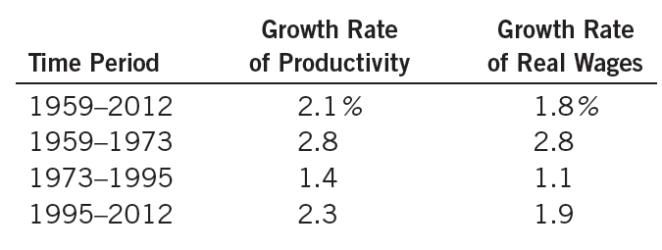
Table 2
Productivity and Wage Growth in the United States
Source: Bureau of Labor Statistics.
Growth in productivity is measured here as the annualized rate of change in output per hour in the nonfarm business sector. Growth in real wages is measured as the annualized change in compensation per hour in the nonfarm business sector divided by the implicit price deflator for that sector. These productivity data measure average productivity—the quantity of output divided by the quantity of labor—rather than marginal productivity, but average and marginal productivity are thought to move closely together.
© 2015 Cengage Learning. All Rights Reserved. May not be copied, scanned, or duplicated, in whole or in part, except for use as permitted in a license distributed with a certain product or service or otherwise on a password-protected website for classroom use.

Slide 26
Land and Capital
Capital
  Equipment and structures used to produce goods and services
Equilibrium
  Purchase price
    Price a person pays to own that factor of production indefinitely
  Rental price
    Price a person pays to use that factor for a limited period of time
© 2015 Cengage Learning. All Rights Reserved. May not be copied, scanned, or duplicated, in whole or in part, except for use as permitted in a license distributed with a certain product or service or otherwise on a password-protected website for classroom use.

Slide 27
Equilibrium: Land and Capital
Wage
  Rental price of labor
Rental price of land & capital
  Determined by supply and demand
  Demand – derived demand
    Reflects marginal productivity of the factor
Each factor’s rental price
  Value of marginal product for the factor
© 2015 Cengage Learning. All Rights Reserved. May not be copied, scanned, or duplicated, in whole or in part, except for use as permitted in a license distributed with a certain product or service or otherwise on a password-protected website for classroom use.

Slide 28
Figure 7
The Markets for Land and Capital
(a) The market for land
(b) The market for capital
Rental
price of
land
Rental
price of
capital
Supply
Supply
P
P
Demand
Demand
0
Q
Quantity
of land
0
Q
Quantity of
capital
Supply and demand determine the compensation paid to the owners of land, as shown in panel (a), and the compensation paid to the owners of capital, as shown in panel (b). The demand for each factor, in turn, depends on the value of the marginal product of that factor.
© 2015 Cengage Learning. All Rights Reserved. May not be copied, scanned, or duplicated, in whole or in part, except for use as permitted in a license distributed with a certain product or service or otherwise on a password-protected website for classroom use.

Slide 29
Equilibrium: Land and Capital
Equilibrium purchase price depends on
  Current value of the marginal product
  Value of the marginal product expected to prevail in the future
© 2015 Cengage Learning. All Rights Reserved. May not be copied, scanned, or duplicated, in whole or in part, except for use as permitted in a license distributed with a certain product or service or otherwise on a password-protected website for classroom use.

Slide 30
Land and Capital
Linkages among the factors of production
  Price paid to any factor of production
    = Value of the marginal product of that factor
  Marginal product of any factor depends on
    Quantity of that factor that is available
Diminishing marginal product
  Factor in abundant supply
    Low marginal product
    Low price
© 2015 Cengage Learning. All Rights Reserved. May not be copied, scanned, or duplicated, in whole or in part, except for use as permitted in a license distributed with a certain product or service or otherwise on a password-protected website for classroom use.

Slide 31
Land and Capital
Diminishing marginal product
  Factor in scarce supply
    High marginal product
    High price
Change in supply of a factor
  Change in equilibrium factor price
  Change in earnings of the other factors
© 2015 Cengage Learning. All Rights Reserved. May not be copied, scanned, or duplicated, in whole or in part, except for use as permitted in a license distributed with a certain product or service or otherwise on a password-protected website for classroom use.

Slide 32
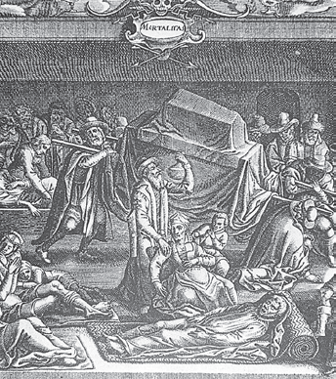
The economics of the Black Death
14thcentury Europe, Black Death (bubonic plague)
  Wiped out about one-third of the population within a few years
  Grisly natural experiment to test the theory of factor markets
Workers who survived the plague were lucky in more ways than one.
© 2015 Cengage Learning. All Rights Reserved. May not be copied, scanned, or duplicated, in whole or in part, except for use as permitted in a license distributed with a certain product or service or otherwise on a password-protected website for classroom use.

Slide 33
The economics of the Black Death
Effects of the Black Death on survivors
  Reduced population: Smaller supply of workers
  Marginal product of labor rises: Higher wages
    Wages doubled
    Economic prosperity for peasant classes
  Marginal product of land fell: Lower rents
    Rents declined 50% or more
    Reduced income for the landed classes
© 2015 Cengage Learning. All Rights Reserved. May not be copied, scanned, or duplicated, in whole or in part, except for use as permitted in a license distributed with a certain product or service or otherwise on a password-protected website for classroom use.

